Slide 1
SQL PORTFOLIO PROJECT
BY RANIT GHATAK

Slide 2
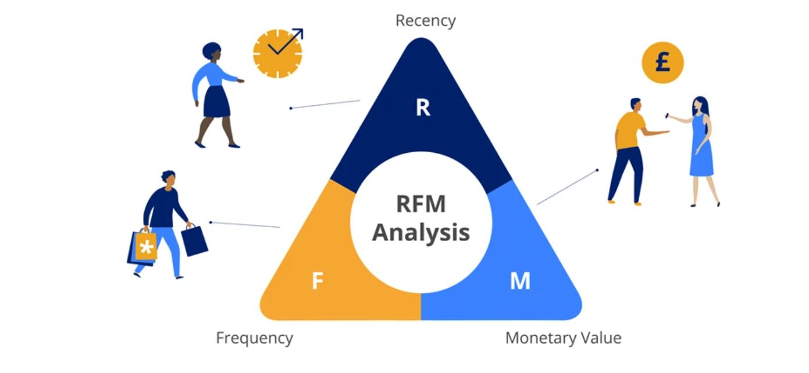

Slide 3
Overview
In this Project I have used RFM Analysis and Correlation to understand the buying pattern of the Customers.
RFM Analysis is used for understanding who are our most valuable Customers.
Correlation between products is used for understanding

Slide 4
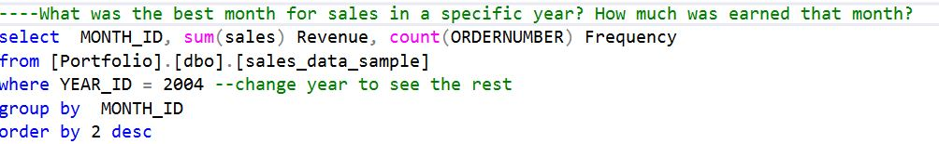
What was the best month for sale in a specific year

Slide 5
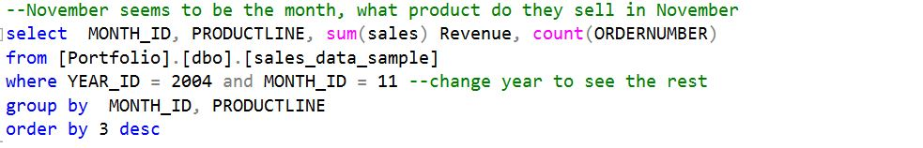
What product do they sell in that month

Slide 6
OVERVIEW OF RFM ANALYSIS
What is RFM (recency, frequency, monetary) analysis? RFM analysis is a marketing technique used to quantitatively rank and group customers based on the recency, frequency and monetary total of their recent transactions to identify the best customers and perform targeted marketing campaigns.

Slide 7
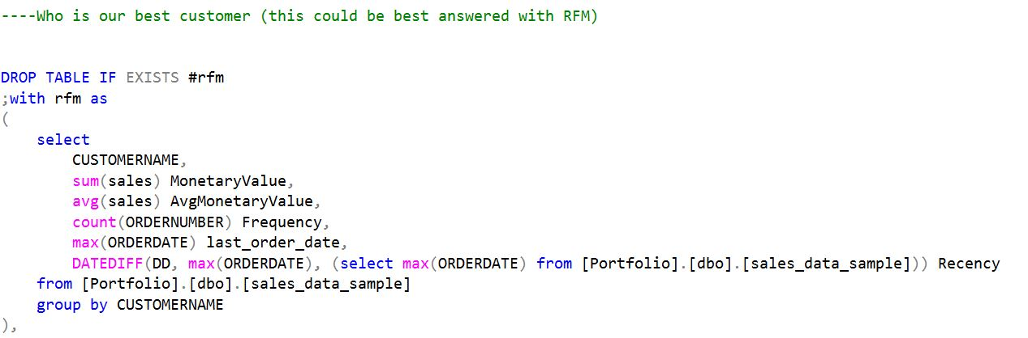
RFM ANALYSIS

Slide 8
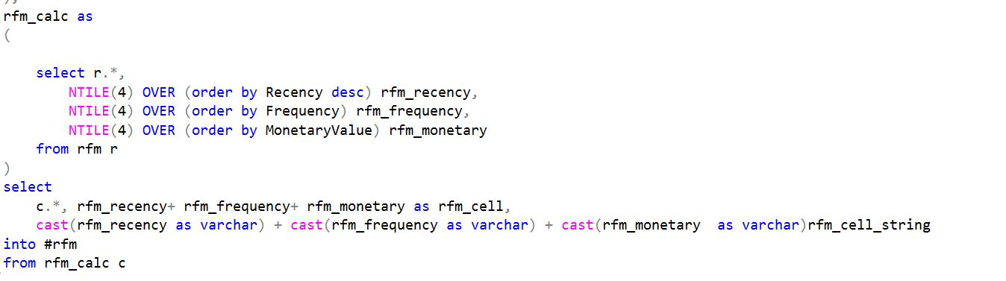
RFM ANALYSIS

Slide 9
CORRELATION ANALYSIS
HERE I HAVE TRIED TO ANALYZE WHICH PAIR OF PRODUCTS ARE FREQUENTLY BOUGHT BY THE CUSTOMERS AND RANKED THE ACCORDING TO CORRELATION COUNT.

Slide 10
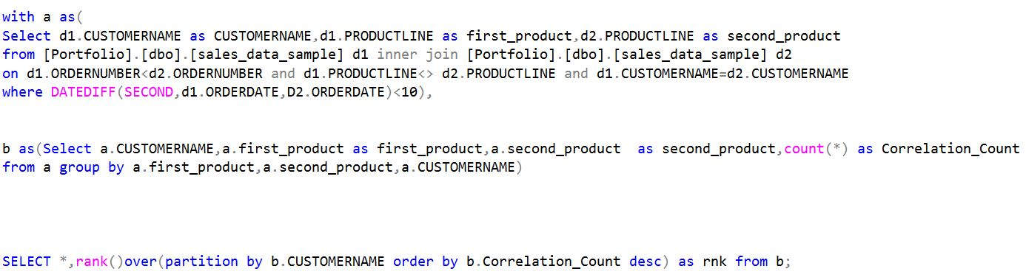
CORRELATION BETWEEN PRODUCTS

Slide 11
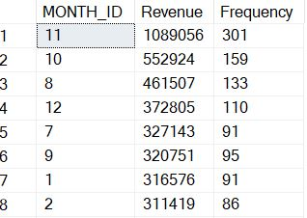
Revenue and frequency per month

Slide 12
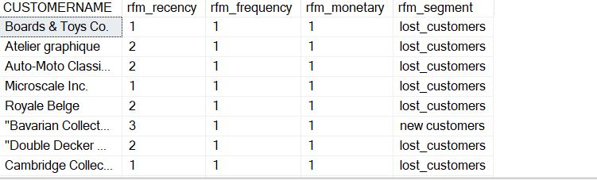
Clusters generated after applying ntile

Slide 13
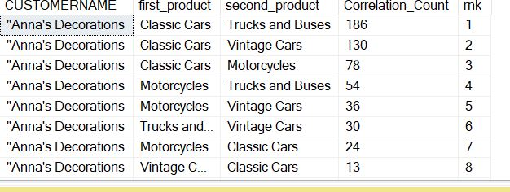
Correlation count and rank per customer

